Slide 1
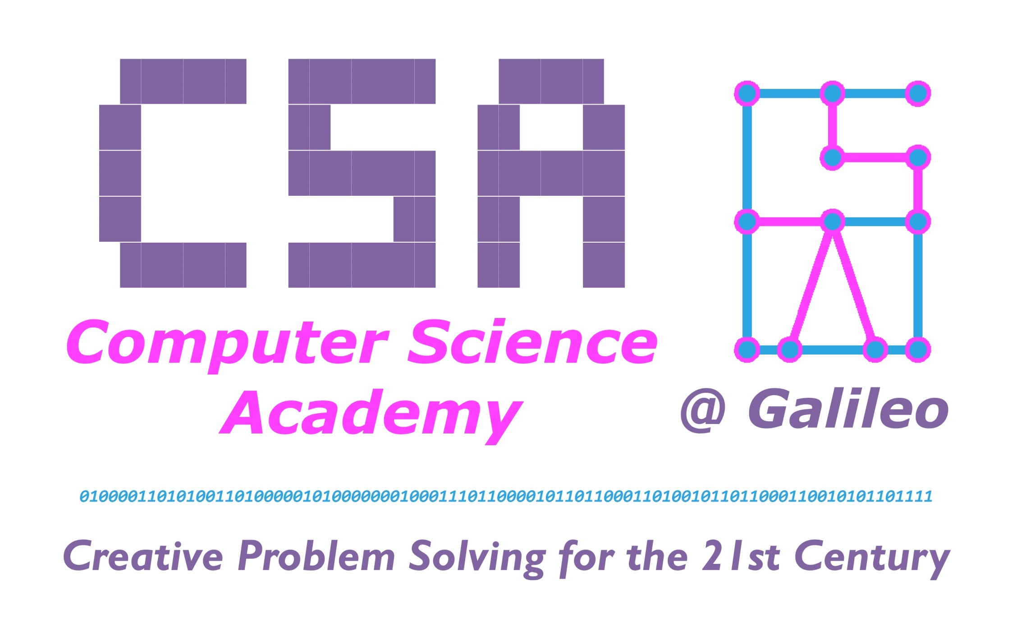
CSINQUIRY.ORG

Slide 2
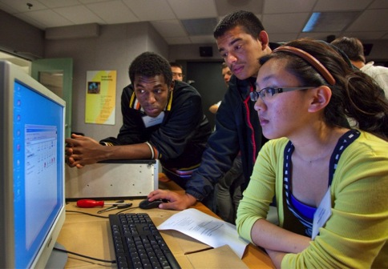
What is Computer Science?
CS is posing a problem in such a way that a computer can help us solve it.
Communicate
Solve problems
Design and imagine
Share, store, retrieve or manipulate information
Notes:
Introduction – Learn a bit about computer
Say: In a nutshell, here’s a definition of CS we’ll operate from today. Read the slide.

Slide 3

What is Computer Science?
CS is designing computing devices and programming them
Notes:
Introduction – Learn a bit about computer
Say: All that work goes into making technology that works for us.
Read slide, “CS is designing…”
Then say: Think about cell phones. They are just tiny computers. Any time you change the ring tone or screen background or launch an app you are running a computer program. A layer of software a human programmer wrote interprets your key strokes so the computer changes how it operates.
Have any of you ever wanted to make a phone work better or differently? [responses]. A lot of computer science is about improving technology-- making it faster, smaller or able to do new things. It’s powerful!

Slide 4
Why Computer Science?
Computational thinking is important across ALL subjects, not just computer science.
More than 50 percent of all math and science jobs are for computer scientists.
Computer science jobs are the highest-paying jobs for new graduates.
Computing jobs are growing 3 times faster than the number of computer science graduates.
Information and communication technologies is the fastest growing job sector in San Francisco.
You can create cool mobile apps, games, and other software that have an impact on society.

Slide 5
Computing Connects
music
business
manufacturing
communications
advertising
engineering
accounting
the arts
safety systems
science
Only 50% of tech jobs are at technology companies
criminal justice
recreation
veterinary medicine
sports
agriculture
pharmaceuticals
banking
law
automotive
photography
military
architecture
medicine
entertainment
design
politics
journalism
transportation
health care
Notes:
Computing is at the heart of everything
Say: You might be surprised to know only half of computing jobs are in high tech companies! You could mash up your interests in other careers with technology and work anywhere.
Ask: Do you see a field here that interests you? Could you imagine how technology might be important to it? (Let student’s reply)

Slide 6



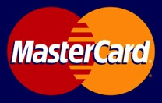
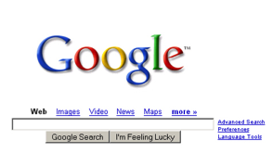
Computer Science is information systems
Are you someone who:
Understands relationships?
Likes to do things efficiently?
Is interested in business and connecting people?
Notes:
Computing is at the heart of everything
INFORMATION SYSTEMS
Say: Computing connects people to businesses and to information and to each other!

Slide 7
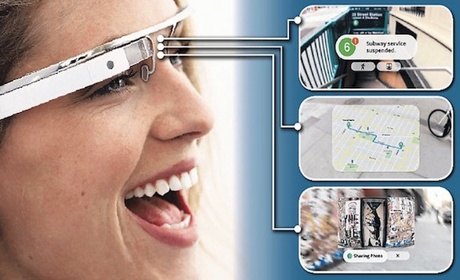
Computer Science is engineering new products
Do you want to:
Create devices that can do the work for you?
Google Glass
Notes:
Computing is at the heart of everything.
COMPUTER ENGINEERING
Say: Computing is part of designing new products, not just technical ones. But here’s Google Glass, the first wearable computer.

Slide 8
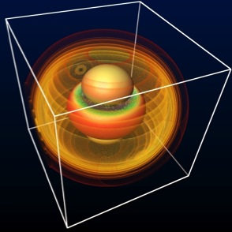
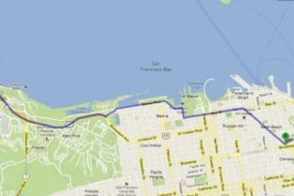
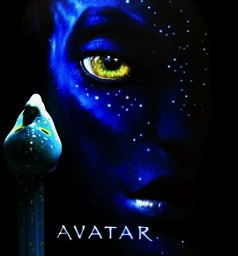
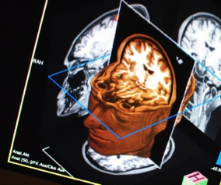
Computer Science is visualizing and creating imagery
Do you like:
Art?
Science?
Game Design?
Theater?
Movies?
Notes:
Computing is at the heart of everything
VISUALIZATION AND GRAPHICS
Computing is a big part of visualization and imagery. You’ve seen computer-generated graphics in movies and video games. It’s useful in science, too, to picture a problem or process.

Slide 9
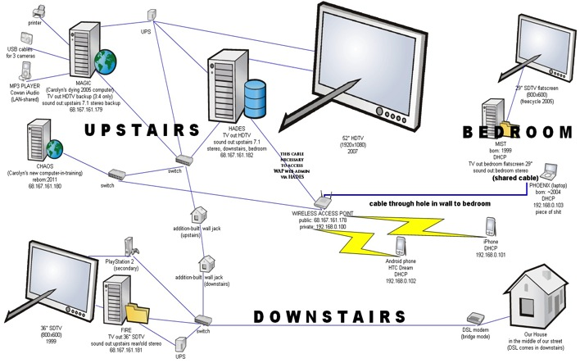
Computer Science is Infrastructure and Networks
Do you want to help:
Keep computer systems up and running?
Invent new ways for technologies to connect?
Notes:
Computing is at the heart of everything
INFRASTRUCTURE AND NETWORKS
Computing is also the connections, the networks between computers.

Slide 10

Computer Science is Computer Forensics and Cyber Security
Do you want to help:
Solve crime?
Keep us safe?
Secure information?
Notes:
Computing is at the heart of everything
COMPUTER FORENSICS AND CYBER SECURITY
Say: Lots of people work to keep computers safe from hackers. People also use computers to solve crimes.

Slide 11
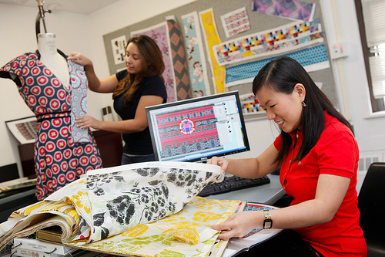
Computer Science is Design
Do you want to:
Make models?
Design cars, houses, fashion, anything?
Notes:
Computing is at the heart of everything.
DESIGN and MODELING
Say: People in the arts and architecture rely on design software all the time.
Say: Now let’s talk about how people get into computing

Slide 12
Is Computer Science for me?
Creative
Language skills
Logical/mathematical
Like technology
Have multiple interests
Like understanding how things work/curious
Don’t give up easily/challenge yourself
Calm under stress
Like working with others
Global mindset

Slide 13
Focus on Computer Science
Themes and Practices:
The creative nature of computing
Technology as a tool for solving problems
The relevance of computer science and its impact on society
Current courses available @ Galileo:
Exploring Computer Science, mainly 10th grade
AP Computer Science Principles, mainly 11th grade
AP Computer Science A, mainly 12th grade

Slide 14
Contact Info
Lead Instructor: Mr. Danny Tan Email: tand@sfusd.edu Phone: 415-749-3430 ext. 3102 Location: Room 102 (first floor) Website: csinquiry.org

Slide 15

Exploring Computer Science (10th grade)
Computers and the Internet
Societal impacts of computing
Algorithms and abstraction
Connections between Math and Computer Science
Programming
Models of Intelligent Behavior
Web page design and development
Data and Information
Electronics/Robotics

Slide 16
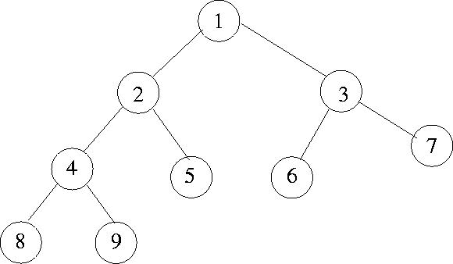
Exploring CS is…
Algorithms and problem solving
Notes:
Developing step by step solutions to problems

Slide 17

Exploring CS is…
Web Design
Notes:
Designing, prototyping, and testing web pages

Slide 18
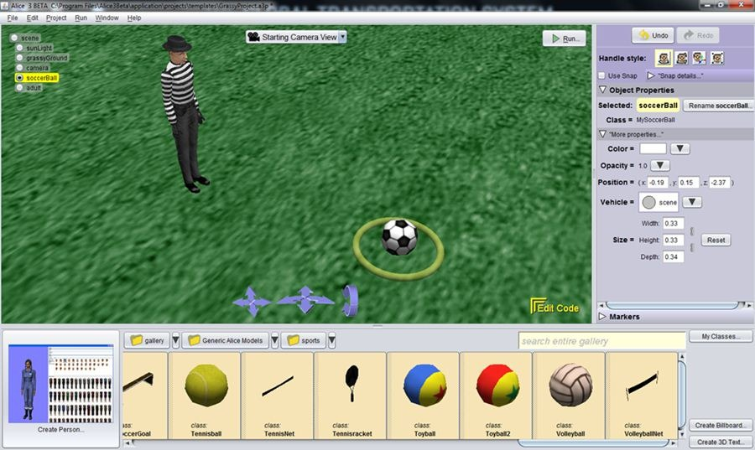
Exploring CS is…
Programming
Notes:
Giving directions to the computer for models, animations, and games

Slide 19
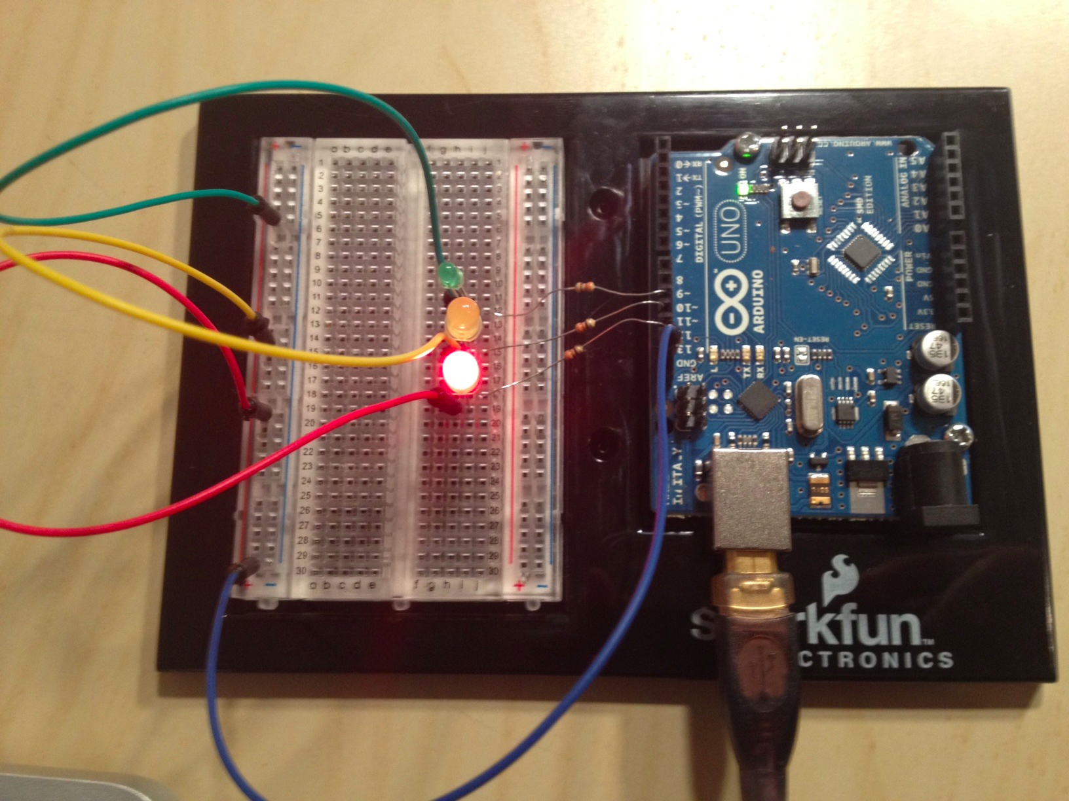
Exploring CS is…
Electronics Prototyping
Notes:
Creating and programming everyday electronics (such as a traffic light)

Slide 20
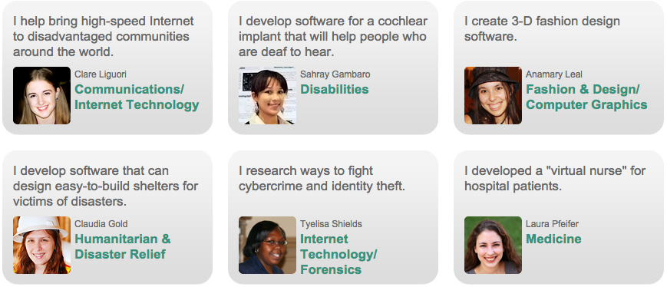
Exploring CS is…
Societal Impacts
Notes:
CS impacts many other fields.

Slide 21
What if…?
What if I want to be prepared for college?
Exploring CS meets the “g” subject requirement for UC/CSU college admission
What if I need to take P.E.?
If you are taking Exploring CS, you don’t have to take the second year of P.E. until 12th grade
Exploring CS looks better on college apps than P.E.

Slide 22
What if…?
What if I haven’t programmed before?
Exploring CS is perfect for you! It’s designed for beginners with no prior experience needed.
Consider taking the course with a friend (they probably want to take the course too!)
What if I’m not good at math?
Computer science does involve math, but not everything is 1s and 0s. Language skills and critical thinking are just as, if not more, important for success.

Slide 23



AP Computer Science Principles (11th grade)
First Semester: User Interface Design and Android applications
Focus on Mobile Apps and the Design cycle
Second semester: programming in the Python language

Slide 24


Introducing AP® Computer Science Principles
Creative Thinkers Wanted
Notes:
[Replace Image]

Slide 25
Myth vs. Reality
MYTH: Computer Science is all about word processing, sending email, and using the Internet.
REALITY: While computer science makes those things possible, it’s less about using specific applications than using the computer to address problems through new applications.
MYTH: Computer science consists of sitting in front of a computer by yourself, coding for hours on end.
REALITY: Computer science is creative and collaborative! Computers are elaborate tools for solving real-world problems, and teamwork is essential to developing those solutions.
MYTH: When I think of computer science, the only career that comes to mind is programming.
REALITY: Studying computer science can lead to hundred of career paths, including 3-D animation, engineering, entertainment, app development, medicine, visual design, robotics, political analysis and much, much more.

Slide 26
Myth vs. Reality
MYTH: Computer science is only for boys.
REALITY: Computer science is for everyone. Boy or girl, if you are creative, like to work in a team, and are interested in how technology can solve problems, computer science is for you.
MYTH: I’m not good at math, so I won’t be good at computer science.
REALITY: Like all sciences, computer science does involve math, but not everything is 1s and 0s. Language skills and critical thinking are just as, if not more, important for success.
Notes:
First computer programmer was a girl (Ada Lovelace). Some of the most famous computer scientists were female (e.g. Grace Hopper coined the term debugging).

Slide 27
What do celebrities say about computer science?
Karlie Kloss: Coding is a superpower
NBA star Chris Bosh on Computer Science

Slide 28
What is AP® Computer Science Principles (AP CSP)?
Did you know that of the more than 9 million STEM jobs available in the next decade, half will require computing experience?
AP CSP, launching in fall 2016, prepares you by:
Introducing you to the essential ideas of computer science.
Challenging you to explore how computing and technology impact the world around you.
Providing a foundation of knowledge that can be applied across disciplines, no matter what your major or career focus- from STEM fields to music and the arts. Chances are, no matter what field you’re interested in, computers play a role.

Slide 29
What makes AP® CSP special?
Creatively address world issues and concerns
Use the same processes and tools as artists, musicians, engineers, computer scientists and others to bring ideas to life
Conceptualize and build digital projects, such as videos or mobile apps, that have practical, real-world use
Learn how to identify threats to cybersecurity and ways to use the internet to address such concerns
“AP Computer Science Principles opened my mind to just about everything. I learned that computer science and programming is not just for some people — it’s for anybody.” — Mikiyah Smith, Sophomore

Slide 30
What do my peers say about AP CSP?
https://www.youtube.com/watch?v=S1vFrz4NETg

Slide 31
What do my peers say about AP CSP?
Students who took AP CSP in pilot schools say the course
Gives the autonomy to pursue their passion
Prepares for many different jobs in the future
Gives freedom to select computing innovations they want to investigate
Allows students to collaborate with peers to solve problems
Leads to many creative possibilities

Slide 32
What is AP CSP about?
What it’s about | The fundamentals of computing, including problem solving, working with data, understanding the Internet, cybersecurity, and programming
Goal | Broadening participation in computer science and other STEM fields by exposing you to multiple aspects of computing
The exam | Two projects (one written and one computer-based) during the course One end-of-year exam: multiple-choice

Slide 33
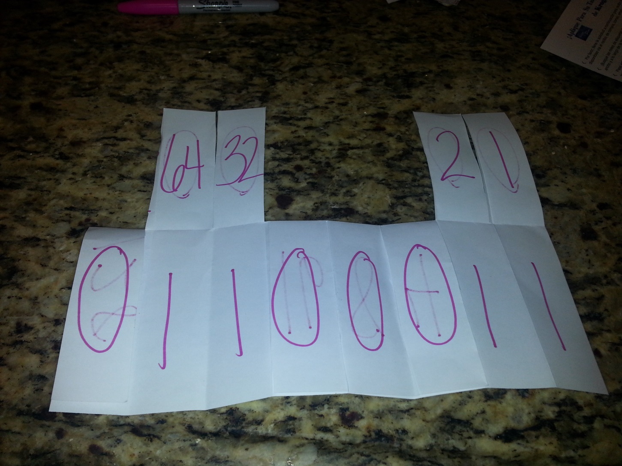
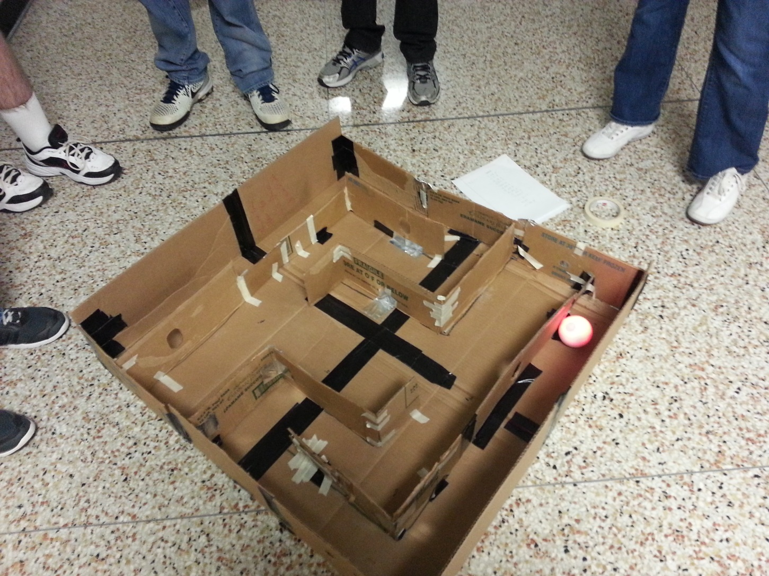
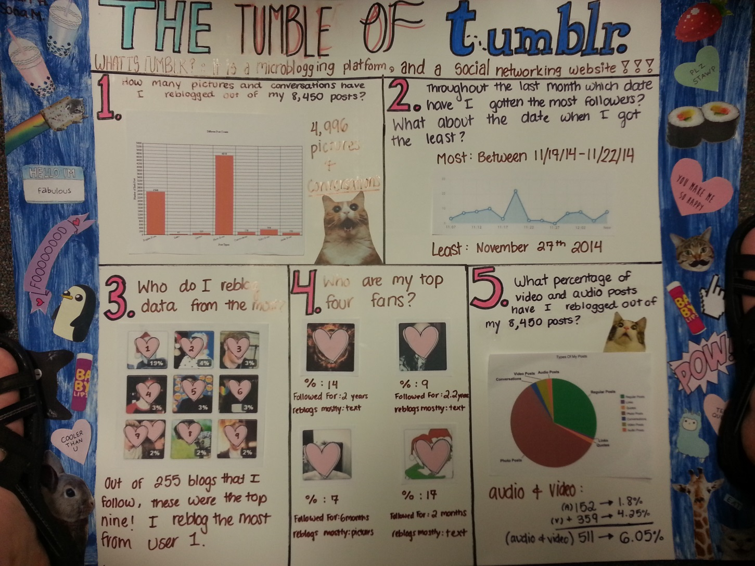
What does AP CSP cover?
Creativity
Create a computational artifact for creative expression.
Abstraction
Explain how binary sequences are used to represent digital data.
Data and Information
Extract information from data to
discover and explain connections,
patterns, or trends.
Notes:
Visit collegeboard.org/CSP Course Details page for more information on what is covered under each big idea.
Big Idea 1: Creativity
Computing is a creative discipline where creation of computational artifacts can take a lot of different forms, like remixing digital music, generating animations, developing websites, and writing programs.
Big Idea 2: Abstraction
In computer science, abstraction is a central problem-solving technique. You will learn how abstraction is a natural part of what they do every day. Some of the areas where abstractions will be taught and applied are in the creation of programs and models and simulations as well as looking at the way in which the computers use abstractions in terms of number systems, like binary, to represent digital data.
Big Idea 3: Data and Information
Data and information facilitate the creation of knowledge. Managing and interpreting an overwhelming amount of raw data is part of the foundation of our information society and technology. In this course you will work with data to discover connections, patterns, or trends.

Slide 34
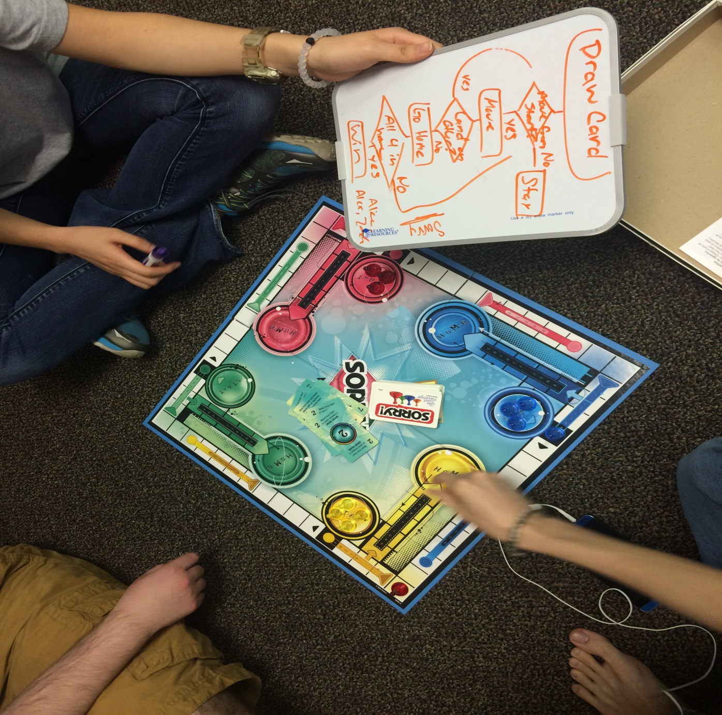
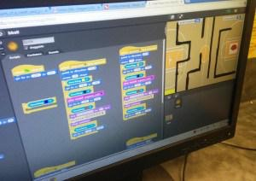
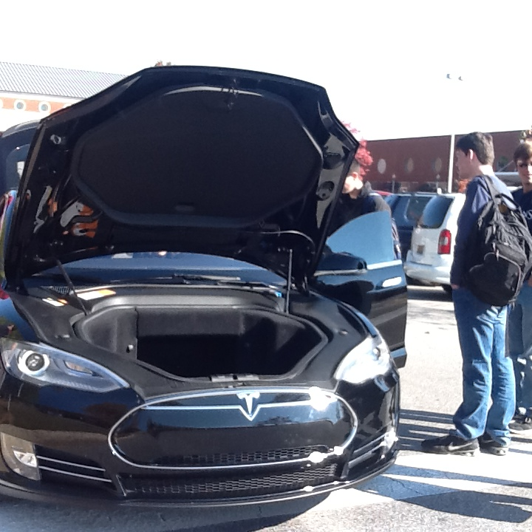
What does AP CSP cover?
Algorithms
Express an algorithm in a language.
Programming
Collaborate to develop a program.
Global Impact
Analyze the beneficial and
harmful effects of computing.
The Internet
Explain characteristics of the Internet
and the systems built on it.
Notes:
Big Idea 4: Algorithms
Algorithms are used to develop and express solutions to computational problems. They are used to describe a process. Think about the rules involved in playing your favorite game and the process or technique you might use to win the game. This process is an algorithm. In this course you will work with algorithms in many ways: You will develop original algorithms, implement algorithms in a programming language, and analyze algorithms.
Big Idea 5: Programming
Programming enables problem solving, human expression, and creation of knowledge. It results in the creation of software, and it facilitates the creation of computational artifacts, including music, images, and visualizations. In this course you will be introduced to the fundamental concepts of programming that can be applied across a variety of projects and languages. You will learn how to work collaboratively to create programs for creative expression or to solve a problem.
Big Idea 6: The Internet
The Internet and systems built on it have a profound impact on society. Many of you are using the Internet to complete homework, conduct research, and to stay connected with your friends. In this course, you will gain insight into how the Internet operates, study characteristics of the Internet and systems built on it, and analyze important concerns such as cybersecurity and how to better keep your information private.
Big Idea 7: Global Impact
Computation has changed the way people think, work, live, and play. In this course, you will become familiar with many ways in which computing enables innovation. Many of you can easily identify the benefits of computing innovations. Your cell phone allow you more freedom because you are able to be reachable by your parents. What you may not have considered are the potential harmful effects of computing. Analyzing both the potential benefits and harmful effects of computing in a number of contexts will help you to weigh these effects when creating your own computing innovations.

Slide 35
What does the AP CSP exam cover?
Part I: Through-Course Assessments
Upload digital artifacts (e.g., a video, spreadsheet, graph, app, electronic slide show) and written responses via a Web-based digital application.
Describe or analyze your work, whether it includes research, the creation of a digital artifact, or the creation of a program.
Part II: End-of-Course AP Exam
Paper and pencil written exam
120 minutes with 74 multiple choice questions
First administration May 2017
Notes:
The AP Computer Science Principles Assessment consists of two parts: a through-course assessment and the end-of-course AP Exam. Both of these parts will measure your achievement of the course learning objectives.
The Through-Course Assessment will allow you to have flexibility and choice in the computational artifacts you will develop. In the Explore Performance task you will investigate a computing innovation that is interesting and meaningful to you. Once you have completed your investigation, you will create a computational artifact using a medium of your choice, such as creating a video, sound, or graphic. When completing the Create Performance Task, you will be allowed to decide what program you will create. The program will either solve a problem or be for your own creative expression. These performance tasks provide you with the opportunity to showcase your interests and what you have learned.

Slide 36
What college majors can you pursue with computing?
Colleges and universities offer many majors that make use of computing, like:
Aerospace Engineering
Applied Physics
Astronomy
Botany
Business Administration
Chemical Engineering
Civil Engineering
Computer Engineering
Computer Forensics
Computer Graphics
Computer Science
Economics
Education
Electrical Engineering
Electronics Technology
Environmental Studies
Geography
Geology
Industrial Engineering
Information Science
Information Technology
Linguistics
Management Information Systems
Marine Biology
Mathematics
Mechanical Engineering
Molecular Biology
Neuroscience
Nuclear Engineering
Physics
Robotics Technology
Statistics
Studio Arts
Web Development
Zoology
collegeboard.org/CSP
Notes:
For a more comprehensive list of majors, visit collegeboard.org/CSP

Slide 37
What can your future be like?
Taking AP Computer Science Principles can lead to a future in over 100 careers.
Advertising Manager
Aerospace Engineer
Aircraft Pilot
Architect
Art Director
Astronomer
Biomedical Engineer
Chemical Engineer
Coach
Computer Programmer
Editor
Economist
Electrical Engineer
Dentist
Forensic Scientist
Financial Manager
General Practitioner
Geoscientist
Graphic Designer
Market Researcher
Mathematician
Medical Scientist
Meteorologist
Multimedia Artist and Animator
Nuclear Engineer
News Analyst, Reporter
Pharmacist
Physical Therapist
Psychiatrist
Real Estate Broker
Statistician
Surgeon
Technical Writer
Translator
Veterinarian
Web Designer
collegeboard.org/CSP
Notes:
Highlighted are a few possible career paths. Visit collegeboard.org/CSP to explore more.

Slide 38
Take the next step
Visit collegeboard.org/CSP to learn more
Speak to your counselor about how to enroll
Consider taking the course with a friend (they probably want to take the course too!)
Previous experience with coding is not required to be successful in this course.
A home computer, while a good idea, is not required to take this course.

Slide 39


Create The Future
Notes:
[Replace Image]

Slide 40
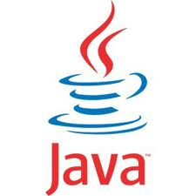


AP Computer Science A (12th grade)
Java Programming Language
Object-Oriented Program Design
Program Implementation
Program Analysis
Standard Data Structures
Standard Algorithms
Computing in Context
Focus on DESIGN and ANALYSIS

Slide 41
How is AP CS A different from AP Computer Science Principles?
Computer Science A
Computer Science Principles
What it’s about | Programming and problem solving using the Java language | The fundamentals of computing, including problem solving, working with data, understanding the Internet, cybersecurity, and programming
Goal | Developing your skills for future study or a career in computer science or other STEM fields | Broadening participation in computer science and other STEM fields by exposing you to multiple aspects of computing
The exam | One end-of-year exam: multiple choice and free-response | Two projects (one written and one computer-based) during the course One end-of-year exam: multiple-choice

Slide 42
Should I take AP CS A?
Should have some programming experience already (if not, but you are still interested, talk to Mr. Tan)
Should take the course if you plan on studying computer science or other science, technology, engineering, math subjects in college

